Slide 1
Discrete Mathematics extended Euclidean algorithm, linear congruence equations
Liangfeng Zhang
School of Information Science and Technology
ShanghaiTech University

Slide 2
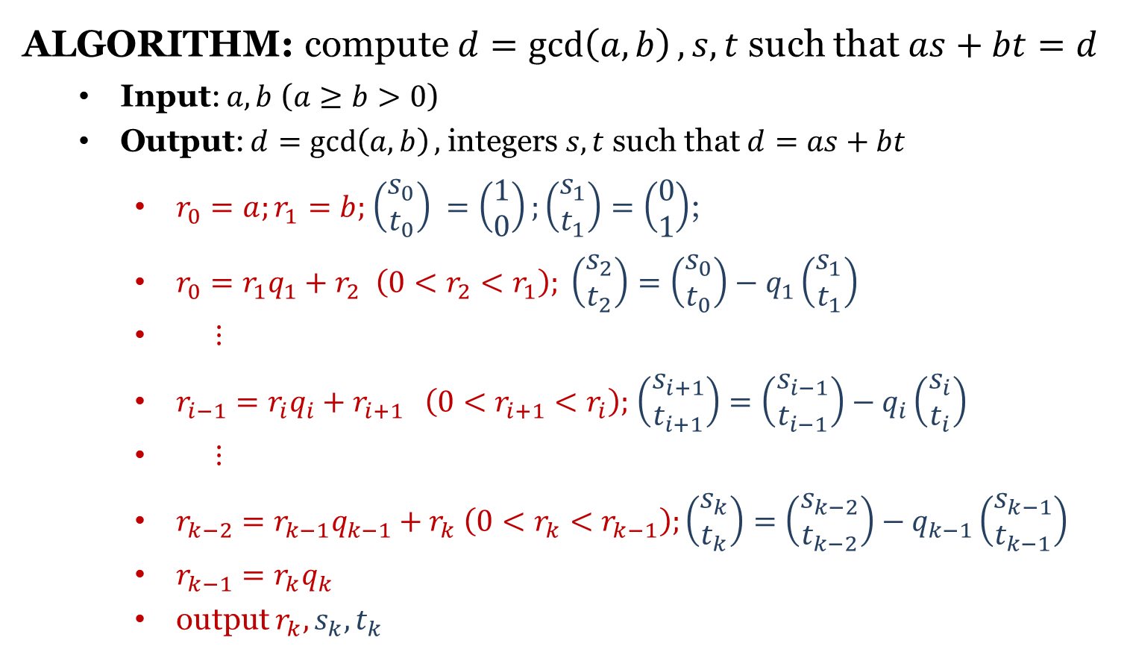
Extended Euclidean Algorithm (EEA)
ALGORITHM: compute $d=\gcd\left(a,b\right),s,t$ such that $as+bt=d$
Input: $a,b$ ($a≥b>0$)
Output: $d=\gcd\left(a,b\right),$ integers $s,t$ such that $d=as+bt$
$r_{0}=a;r_{1}=b;$ $\left(\begin{aligned}s_{0} \\ t_{0}\end{aligned}\right) =\left(\begin{aligned}1 \\ 0\end{aligned}\right);\left(\begin{aligned}s_{1} \\ t_{1}\end{aligned}\right)=\left(\begin{aligned}0 \\ 1\end{aligned}\right)$;
$r_{0}=r_{1}q_{1}+r_{2}$ $\left(0<r_{2}<r_{1}\right); \left(\begin{aligned}s_{2} \\ t_{2}\end{aligned}\right)=\left(\begin{aligned}s_{0} \\ t_{0}\end{aligned}\right)−q_{1}\left(\begin{aligned}s_{1} \\ t_{1}\end{aligned}\right)$
$⋮$
$r_{i−1}=r_{i}q_{i}+r_{i+1} \left(0<r_{i+1}<r_{i}\right);$ $\left(\begin{aligned}s_{i+1} \\ t_{i+1}\end{aligned}\right)=\left(\begin{aligned}s_{i−1} \\ t_{i−1}\end{aligned}\right)−q_{i}\left(\begin{aligned}s_{i} \\ t_{i}\end{aligned}\right)$
$⋮$
$r_{k−2}=r_{k−1}q_{k−1}+r_{k} \left(0<r_{k}<r_{k−1}\right);\left(\begin{aligned}s_{k} \\ t_{k}\end{aligned}\right)=\left(\begin{aligned}s_{k−2} \\ t_{k−2}\end{aligned}\right)−q_{k−1}\left(\begin{aligned}s_{k−1} \\ t_{k−1}\end{aligned}\right)$
$r_{k−1}=r_{k}q_{k}$
output $r_{k}, s_{k}, t_{k}$

Slide 3
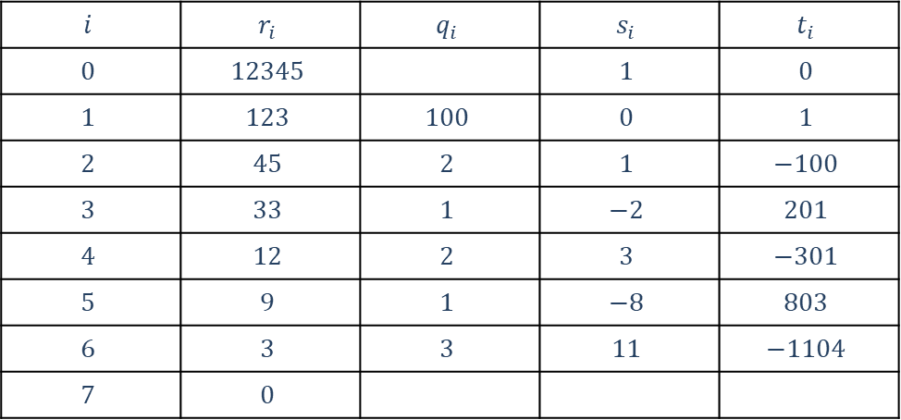
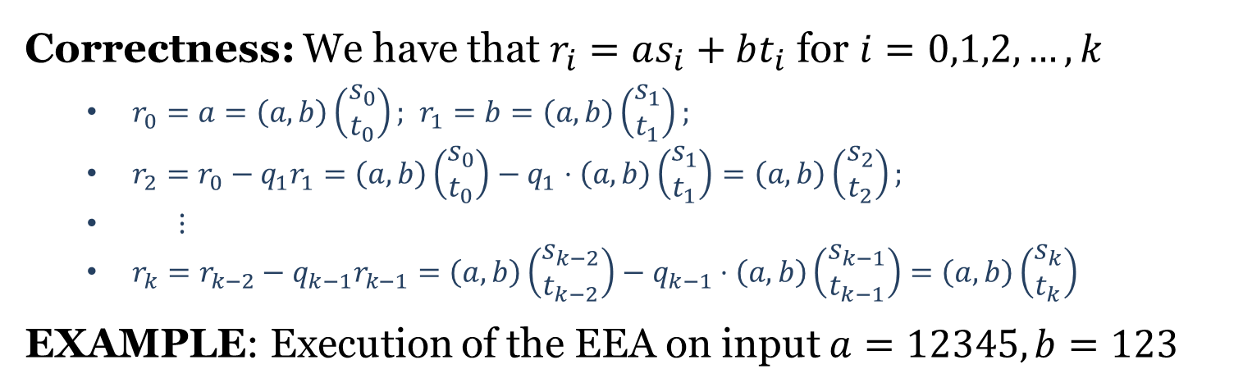
EEA
Correctness: We have that $r_{i}=as_{i}+bt_{i}$ for $i=0,1,2,…,k$
$r_{0}=a=\left(a,b\right)\left(\begin{aligned}s_{0} \\ t_{0}\end{aligned}\right);$ $r_{1}=b=\left(a,b\right)\left(\begin{aligned}s_{1} \\ t_{1}\end{aligned}\right);$
$r_{2}=r_{0}−q_{1}r_{1}=\left(a,b\right)\left(\begin{aligned}s_{0} \\ t_{0}\end{aligned}\right)−q_{1}⋅\left(a,b\right)\left(\begin{aligned}s_{1} \\ t_{1}\end{aligned}\right)=\left(a,b\right)\left(\begin{aligned}s_{2} \\ t_{2}\end{aligned}\right);$
$⋮$
$r_{k}=r_{k−2}−q_{k−1}r_{k−1}=\left(a,b\right)\left(\begin{aligned}s_{k−2} \\ t_{k−2}\end{aligned}\right)−q_{k−1}⋅\left(a,b\right)\left(\begin{aligned}s_{k−1} \\ t_{k−1}\end{aligned}\right)=\left(a,b\right)\left(\begin{aligned}s_{k} \\ t_{k}\end{aligned}\right)$
EXAMPLE: Execution of the EEA on input $a=12345, b=123$
$$i$$ | $$r_{i}$$ | $$q_{i}$$ | $$s_{i}$$ | $$t_{i}$$
$$0$$ | $$12345$$ |  | $$1$$ | $$0$$
$$1$$ | $$123$$ | $$100$$ | $$0$$ | $$1$$
$$2$$ | $$45$$ | $$2$$ | $$1$$ | $$−100$$
$$3$$ | $$33$$ | $$1$$ | $$−2$$ | $$201$$
$$4$$ | $$12$$ | $$2$$ | $$3$$ | $$−301$$
$$5$$ | $$9$$ | $$1$$ | $$−8$$ | $$803$$
$$6$$ | $$3$$ | $$3$$ | $$11$$ | $$−1104$$
$$7$$ | $$0$$

Slide 4
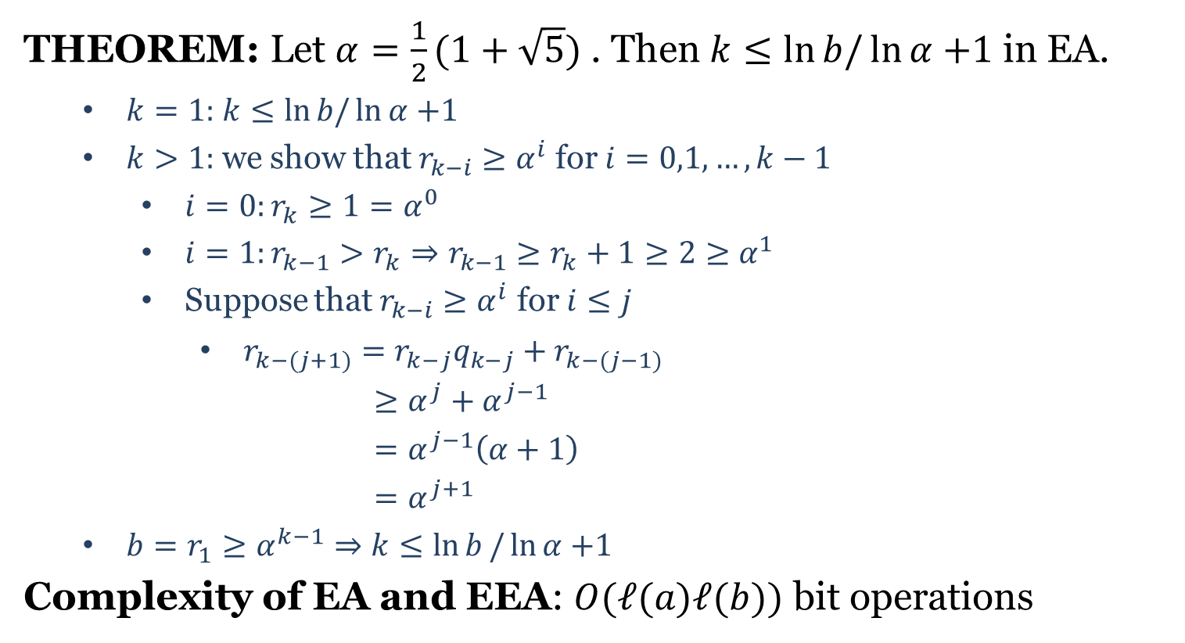
Complexity
THEOREM: Let $α=\frac{1}{2}(1+\sqrt{5})$ . Then $k≤\ln{b/\ln{α}}$ $+1$ in EA.
$k=1:$ $k≤\ln{b/\ln{α}}$ $+1$
$k>1:$ we show that $r_{k−i}≥α^{i}$ for $i=0,1,…,k−1$
$i=0:r_{k}≥1=α^{0}$
$i=1:r_{k−1}>r_{k}⇒r_{k−1}≥r_{k}+1≥2≥α^{1}$
Suppose that $r_{k−i}≥α^{i}$ for $i≤j$
$r_{k−(j+1)}=r_{k−j}q_{k−j}+r_{k−(j−1)}$
$≥α^{j}+α^{j−1}$
$=α^{j−1}\left(α+1\right)$
$=α^{j+1}$
$b=r_{1}≥α^{k−1}⇒k≤\ln{b}/\ln{α}$ $+1$
Complexity of EA and EEA: $O(ℓ(a)ℓ(b))$ bit operations

Slide 5
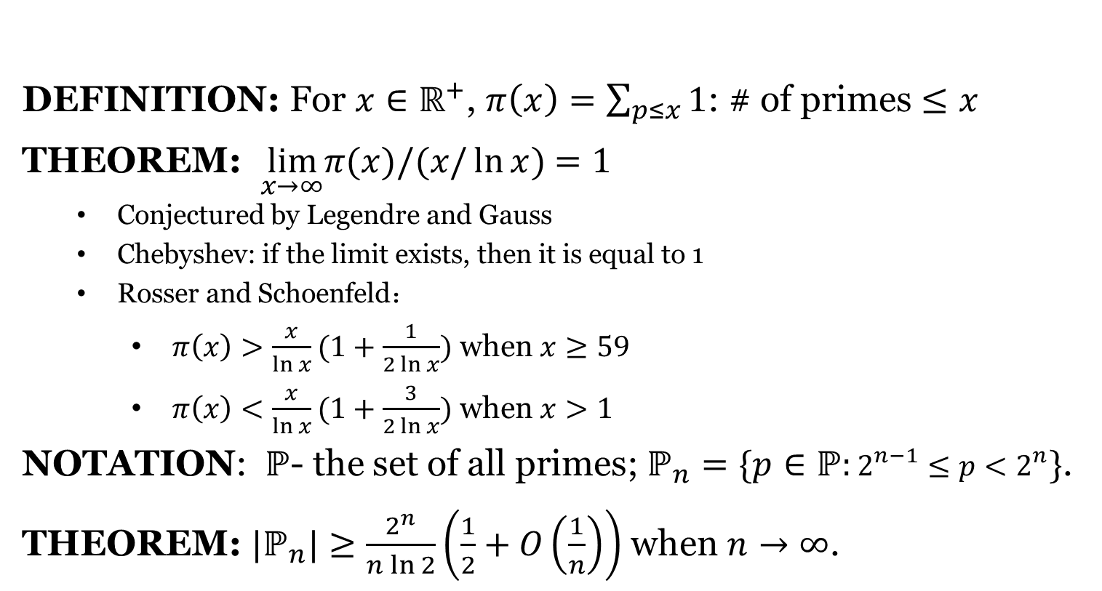
Prime Number Theorem
DEFINITION: For $x∈ℝ^{+}$, $π\left(x\right)=\sum_{p≤x}{1}$: # of primes $≤x$
THEOREM: $\lim_{x→∞}π(x)/(x/\ln{x})$ $=1$
Conjectured by Legendre and Gauss
Chebyshev: if the limit exists, then it is equal to 1
Rosser and Schoenfeld：
$π\left(x\right)>\frac{x}{\ln{x}}(1+\frac{1}{2\ln{x}})$ when $x≥59$
$π\left(x\right)<\frac{x}{\ln{x}}(1+\frac{3}{2\ln{x}})$ when $x>1$
NOTATION: $ℙ$- the set of all primes; $ℙ_{n}=\{p∈ℙ:2^{n−1}≤p<2^{n}\}$.
THEOREM: $|ℙ_{n}|≥\frac{2^{n}}{n\ln{2}}\left(\frac{1}{2}+O\left(\frac{1}{n}\right)\right)$ when $n→∞$.

Slide 6

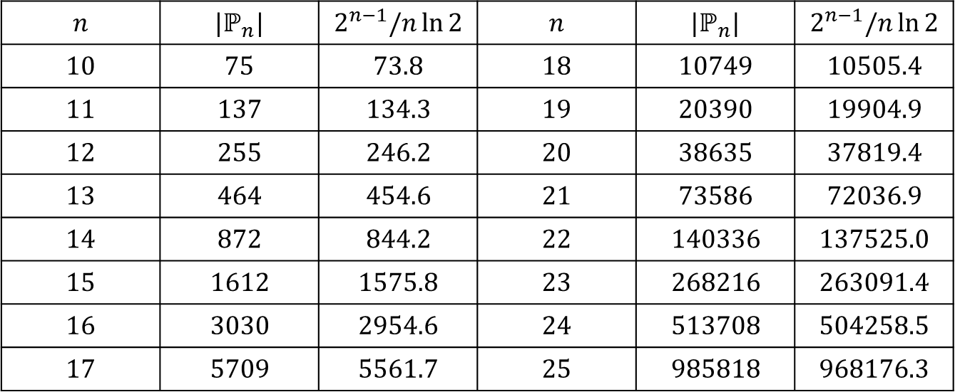
Number of $n$-bit Primes
EXAMPLE: The number of $n$-bit primes for $n∈\{10,…,25\}$.
$$n$$ | $$|ℙ_{n}|$$ | $$2^{n−1}/n\ln{2}$$ | $$n$$ | $$|ℙ_{n}|$$ | $$2^{n−1}/n\ln{2}$$
$$10$$ | $$75$$ | $$73.8$$ | $$18$$ | $$10749$$ | $$10505.4$$
$$11$$ | $$137$$ | $$134.3$$ | $$19$$ | $$20390$$ | $$19904.9$$
$$12$$ | $$255$$ | $$246.2$$ | $$20$$ | $$38635$$ | $$37819.4$$
$$13$$ | $$464$$ | $$454.6$$ | $$21$$ | $$73586$$ | $$72036.9$$
$$14$$ | $$872$$ | $$844.2$$ | $$22$$ | $$140336$$ | $$137525.0$$
$$15$$ | $$1612$$ | $$1575.8$$ | $$23$$ | $$268216$$ | $$263091.4$$
$$16$$ | $$3030$$ | $$2954.6$$ | $$24$$ | $$513708$$ | $$504258.5$$
$$17$$ | $$5709$$ | $$5561.7$$ | $$25$$ | $$985818$$ | $$968176.3$$

Slide 7
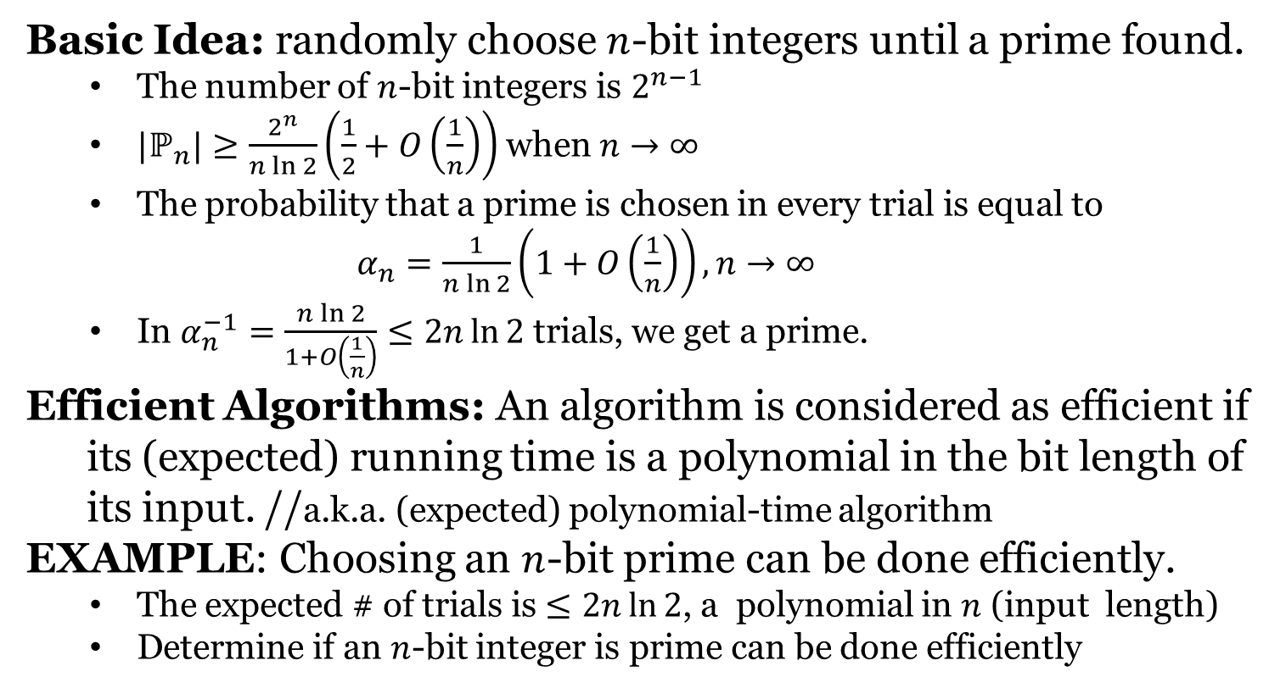
Prime Number Generation
Basic Idea: randomly choose $n$-bit integers until a prime found.
The number of $n$-bit integers is $2^{n−1}$
$|ℙ_{n}|≥\frac{2^{n}}{n\ln{2}}\left(\frac{1}{2}+O\left(\frac{1}{n}\right)\right)$ when $n→∞$
The probability that a prime is chosen in every trial is equal to
$α_{n}=\frac{1}{n\ln{2}}\left(1+O\left(\frac{1}{n}\right)\right), n→∞$
In $α_{n}^{−1}=\frac{n\ln{2}}{1+O\left(\frac{1}{n}\right)}≤2n\ln{2}$ trials, we get a prime.
Efficient Algorithms: An algorithm is considered as efficient if
its (expected) running time is a polynomial in the bit length of
its input. //a.k.a. (expected) polynomial-time algorithm
EXAMPLE: Choosing an $n$-bit prime can be done efficiently.
The expected # of trials is $≤2n\ln{2}$, a polynomial in $n$ (input length)
Determine if an $n$-bit integer is prime can be done efficiently

Slide 9

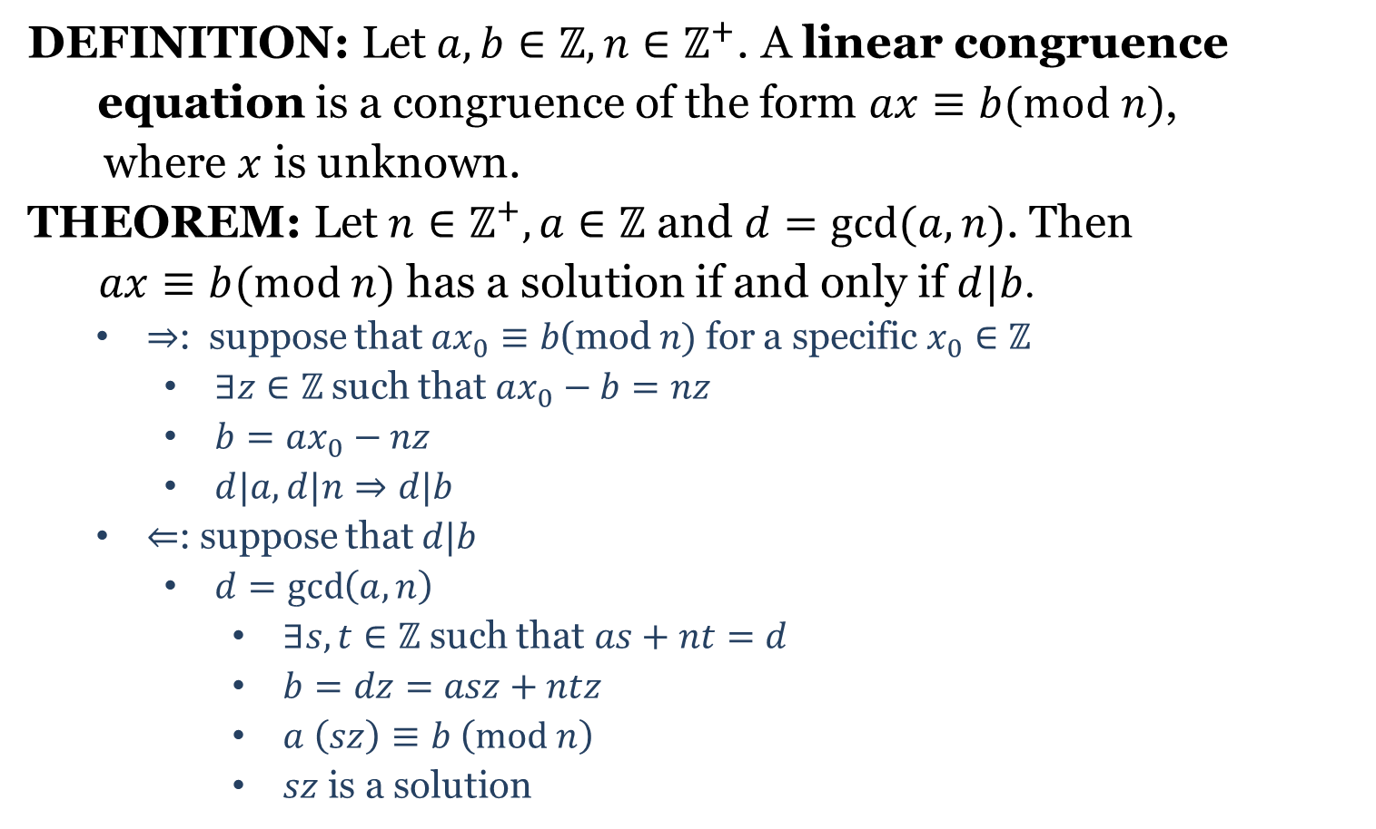
Linear Congruence Equations
DEFINITION: Let$a,b∈ℤ,n∈ℤ^{+}$. A linear congruence
equation is a congruence of the form $ax≡b(mod n)$,
where $x$ is unknown.
THEOREM: Let$n∈ℤ^{+},a∈ℤ$ and $d=\gcd{(a,n)}$. Then
$ax≡b(mod n)$ has a solution if and only if $d|b$.
$⇒$: suppose that $ax_{0}≡b$(mod$n)$ for a specific $x_{0}∈ℤ$
$∃z∈ℤ$ such that $ax_{0}−b=nz$
$b=ax_{0}−nz$
$d|a,d|n⇒d|b$
$⇐$: suppose that $d|b$
$d=\gcd\left(a,n\right)$
$∃s,t∈ℤ$ such that$as+nt=d$
$b=dz=asz+ntz$
$a \left(sz\right)≡b \left(mod n\right)$
$sz$ is a solution
$∃z∈ℤ$ such that $b=dz$

Slide 10

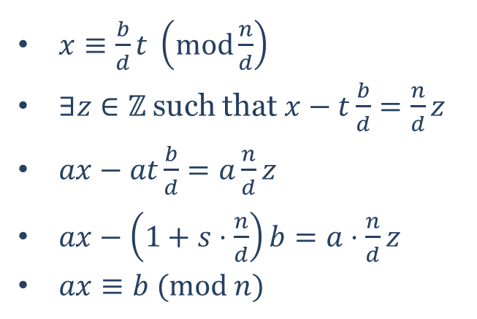
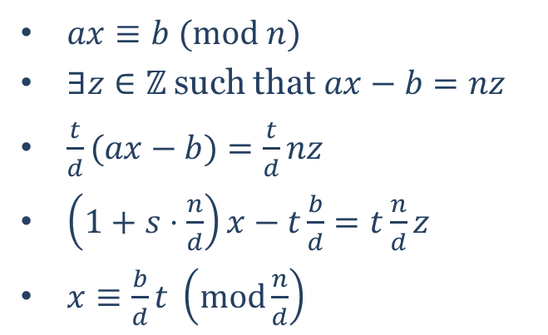
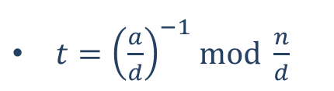
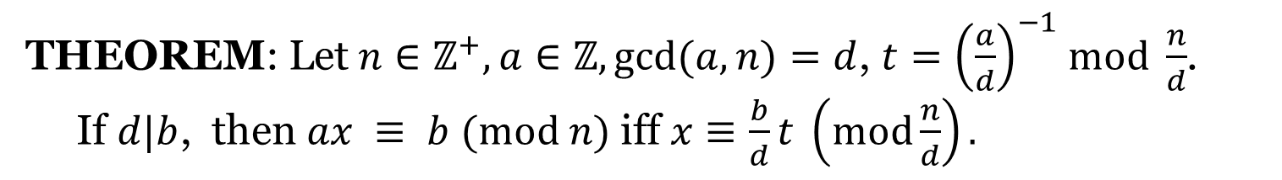

Linear Congruence Equations
THEOREM: Let$n∈ℤ^{+},a∈ℤ,\gcd{(a,n)}=d$, $t={\left(\frac{a}{d}\right)}^{−1}$ $mod \frac{n}{d}$.
If $d|b$, then $ax ≡ b (mod n)$iff $x≡\frac{b}{d}t \left(mod\frac{n}{d}\right).$
$t={\left(\frac{a}{d}\right)}^{−1}$ $mod \frac{n}{d}$
$$t⋅\frac{a}{d}≡1 \left(mod \frac{n}{d}\right)$$
$∃s∈ℤ$ such that $t⋅\frac{a}{d}=1+s⋅\frac{n}{d}$
$ax≡b (mod n)$
$∃z∈ℤ$ such that $ax−b=nz$
$\frac{t}{d}(ax−b)=\frac{t}{d}nz$
$\left(1+s⋅\frac{n}{d}\right)x−t\frac{b}{d}=t\frac{n}{d}z$
$x≡\frac{b}{d}t \left(mod\frac{n}{d}\right)$
$x≡\frac{b}{d}t \left(mod\frac{n}{d}\right)$
$∃z∈ℤ$ such that $x−t\frac{b}{d}=\frac{n}{d}z$
$ax−at\frac{b}{d}=a\frac{n}{d}z$
$ax−\left(1+s⋅\frac{n}{d}\right)b=a⋅\frac{n}{d}z$
$ax≡b (mod n)$

Slide 11
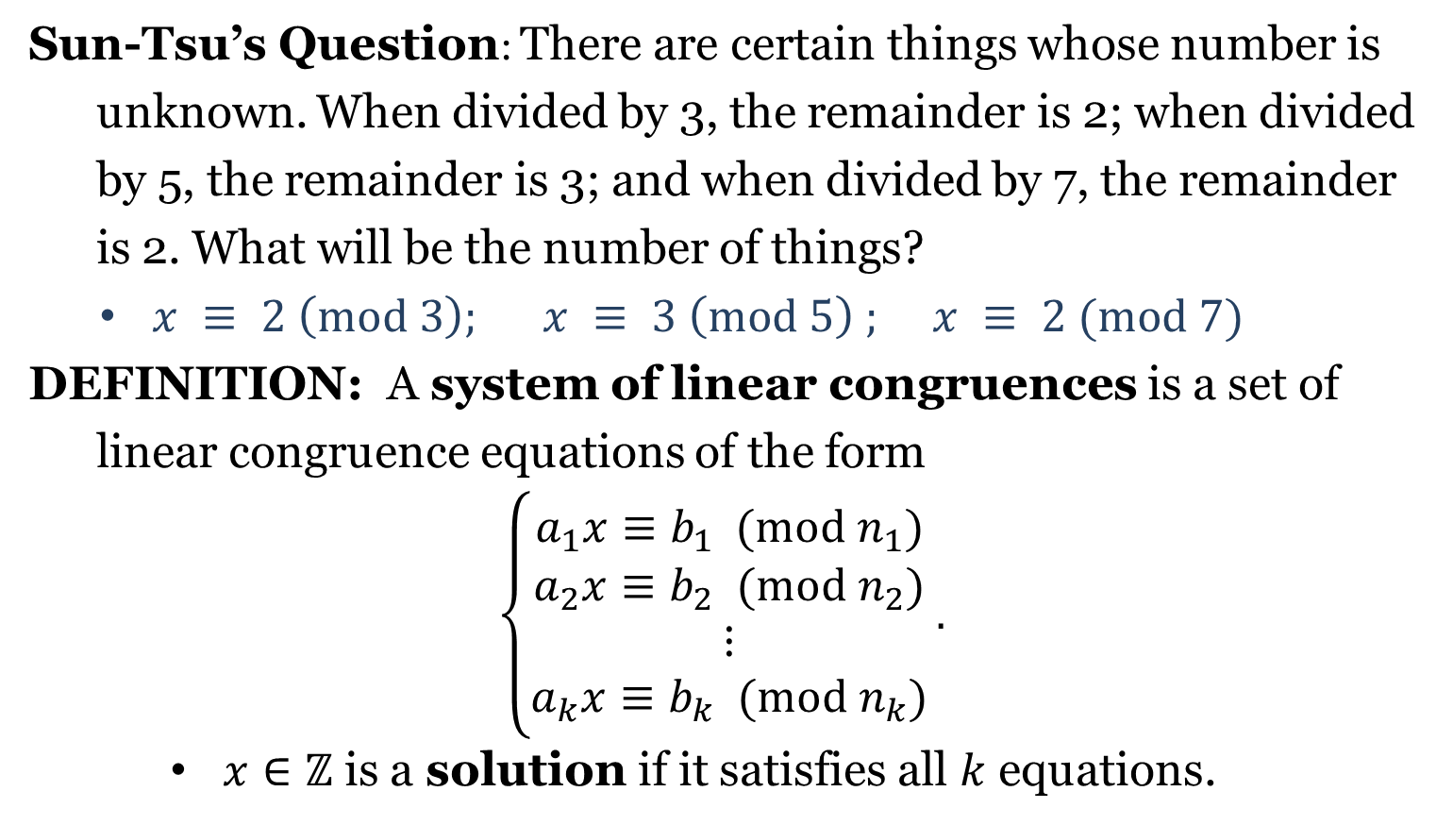
System of Linear Congruences
Sun-Tsu’s Question: There are certain things whose number is
unknown. When divided by 3, the remainder is 2; when divided
by 5, the remainder is 3; and when divided by 7, the remainder
is 2. What will be the number of things?
$x ≡ 2 \left(mod 3\right);$ $x ≡ 3 \left(mod 5\right) ;$ $x ≡ 2 (mod 7)$
DEFINITION: A system of linear congruences is a set of
linear congruence equations of the form
$$\left\{\begin{aligned}a_{1}x≡b_{1} (mod n_{1}) \\ a_{2}x≡b_{2} (mod n_{2}) \\ ⋮ \\ a_{k}x≡b_{k} (mod n_{k})\end{aligned}\right..$$
$x∈ℤ$ is a solution if it satisfies all $k$ equations.

Slide 12

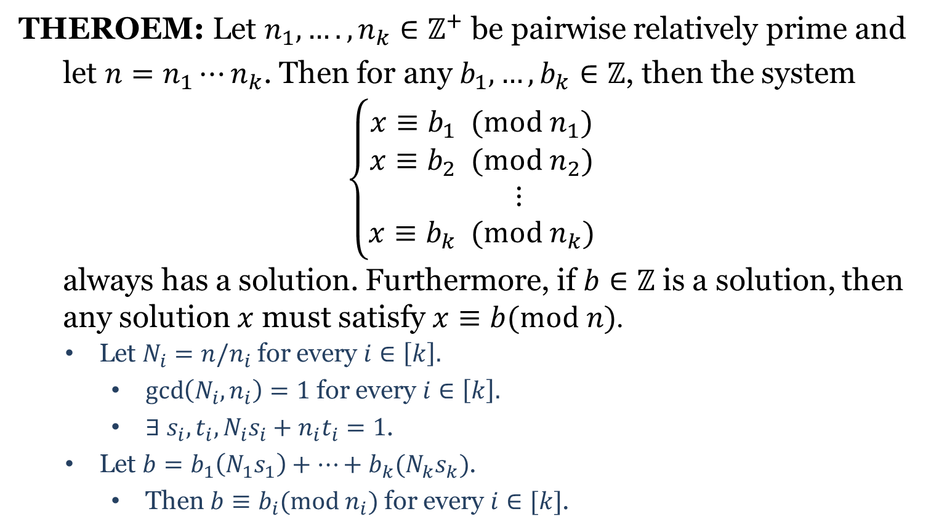
Chinese Remainder Theorem
THEROEM: Let $n_{1}, ….,n_{k}∈ℤ^{+}$ be pairwise relatively prime and
let $n=n_{1}⋯n_{k}$. Then for any $b_{1},…,b_{k}∈ℤ$, then the system
$$\left\{\begin{aligned}x≡b_{1} (mod n_{1}) \\ x≡b_{2} (mod n_{2}) \\ ⋮ \\ x≡b_{k} (mod n_{k})\end{aligned}\right.$$
always has a solution. Furthermore, if $b∈ℤ$ is a solution, then
any solution $x$ must satisfy $x≡b(mod n)$.
Let $N_{i}=n/n_{i}$ for every $i∈\left[k\right].$
$\gcd\left(N_{i},n_{i}\right)=1$ for every $i∈\left[k\right].$
$∃ s_{i}, t_{i}, N_{i}s_{i}+n_{i}t_{i}=1$.
Let $b=b_{1}\left(N_{1}s_{1}\right)+⋯+b_{k}(N_{k}s_{k})$.
Then $b≡b_{i}(mod n_{i})$ for every $i∈[k]$.
$x≡b_{i} \left(mod n_{i}\right)$ for all $i$
$⇒x≡b \left(mod n_{i}\right)$ for all $i$
$⇒n_{i}|(x−b)$ for all $i$
$⇒\left(n_{1}n_{2}⋯n_{k}\right)|(x−b)$
$⇒x≡b (mod n)$

